Slide 1
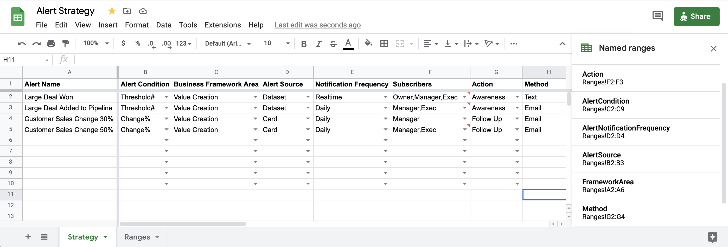
Notes:
https://docs.google.com/spreadsheets/d/1pi9rVxrhBVRHGkm1BbvptsksC4TgTxJg2_zMev5wiho/edit?usp=sharing

Slide 2
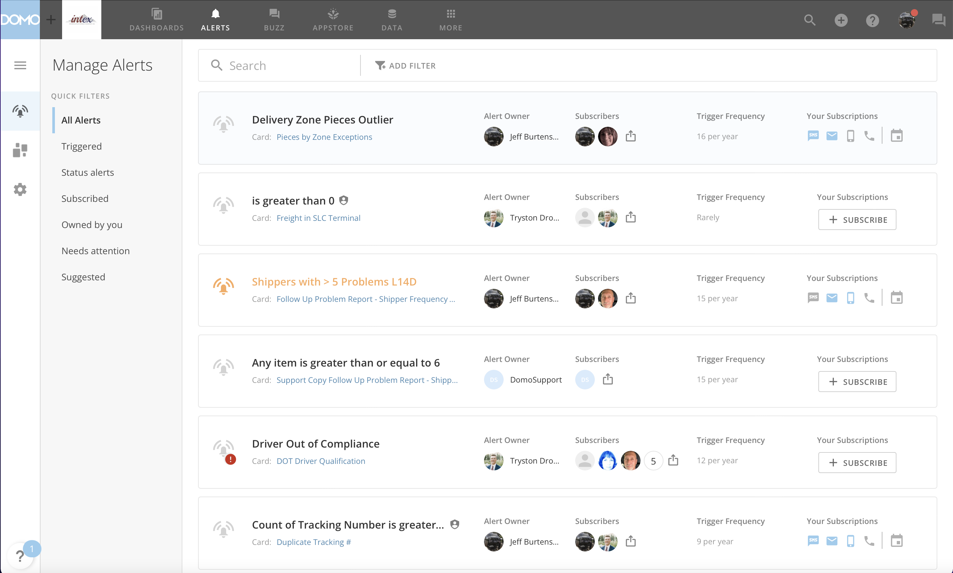
Alert Center
Search
Filter
Share
Quick Filters
Alerts View
Subscription Options
Discover
Settings
Subscribe
Alert Card

Slide 3
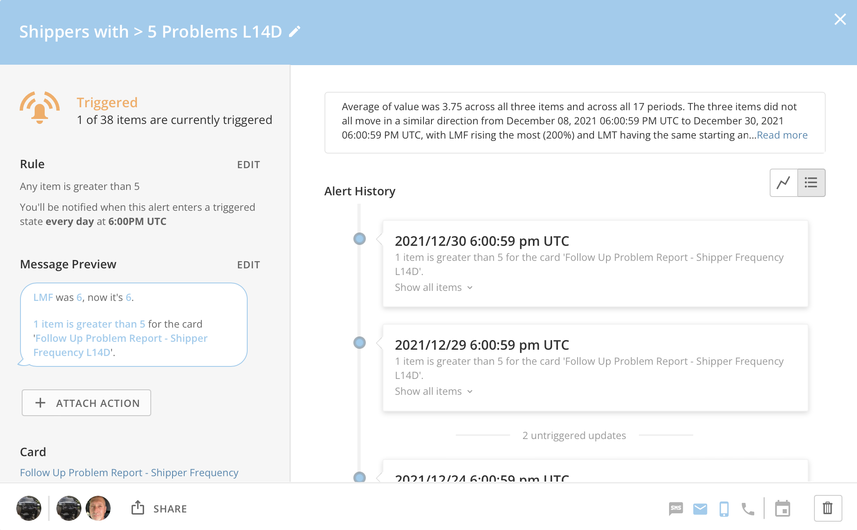
Alert Name
Trigger Status
Rule
Message Preview
Mr. Roboto Analysis
History View Toggle
Owner
Share
Action
Access
Subscription
Delete

Slide 4
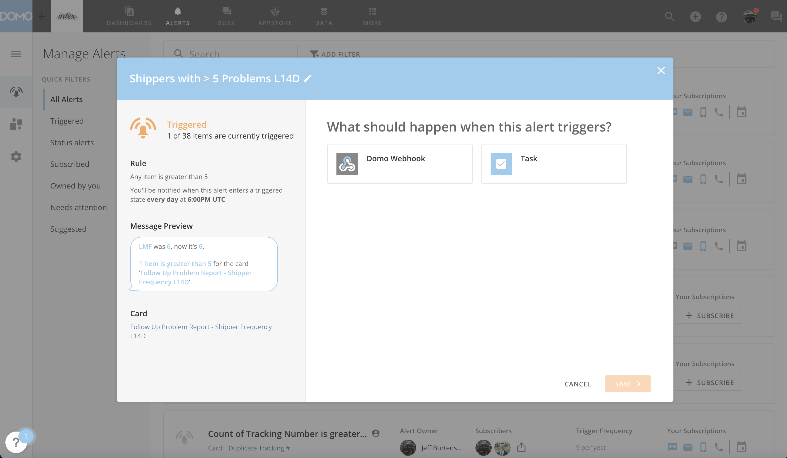

Slide 5
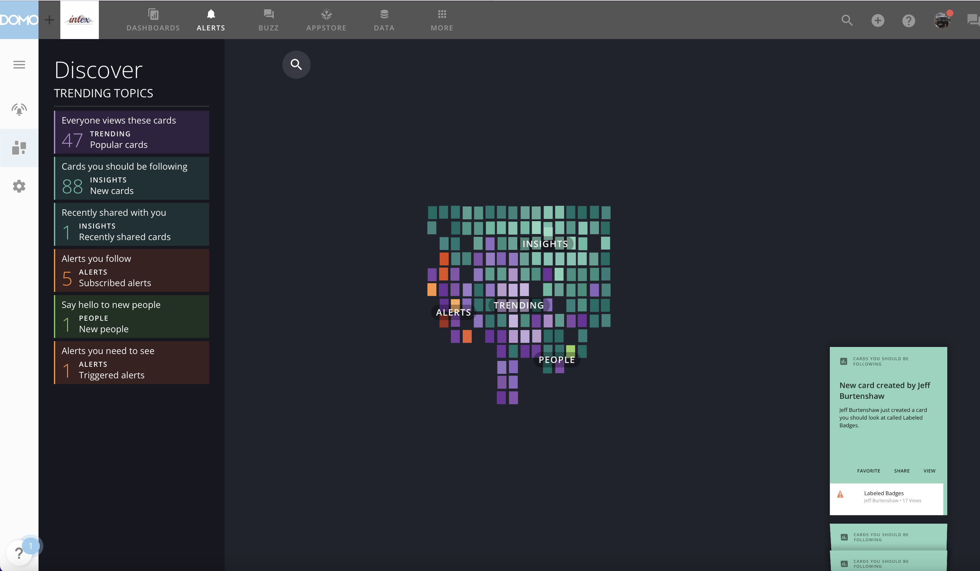
Topics
Search
Heat Map
Hopper

Slide 6
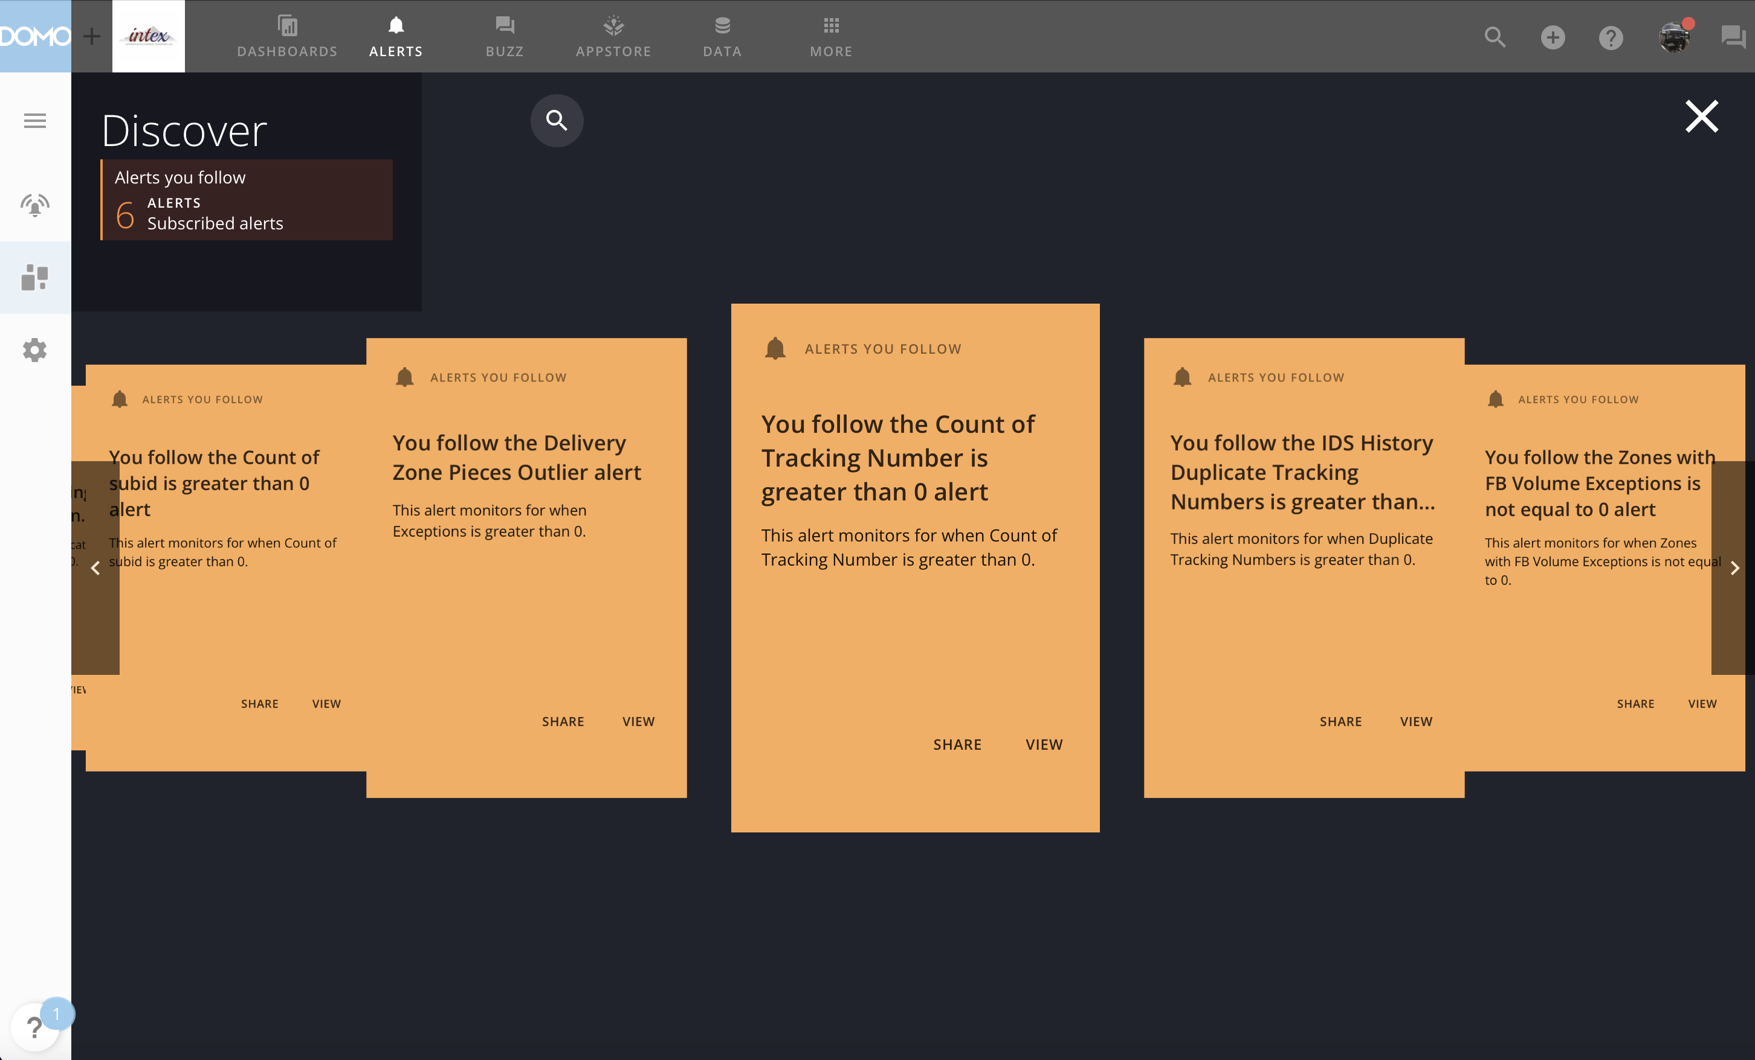

Slide 7
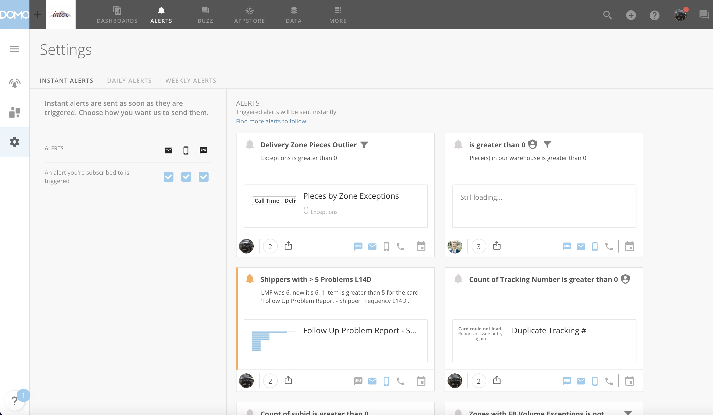
Search to Subscribe
Subscriptions
Notification Channel

Slide 8
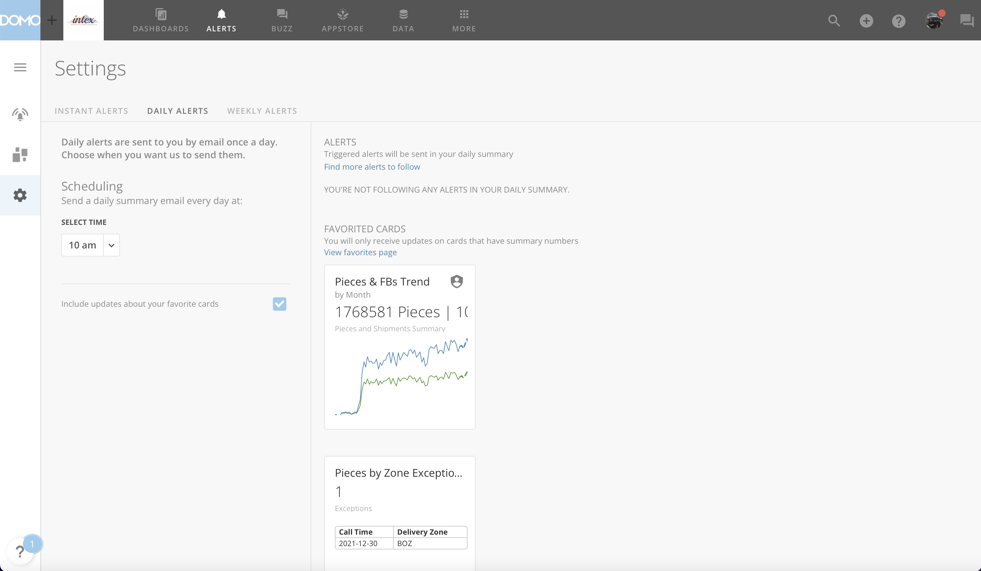
Search to Subscribe
Alerts in Daily Notification
Time of Day
Include Favorites
Favorited Cards
in Daily Notification

Slide 9
